Slide 1
Topic 3: Data Visualisation Introduction to Scatterplots
MM106/BM110
Connor Watret
connor.watret@strath.ac.uk

Slide 2
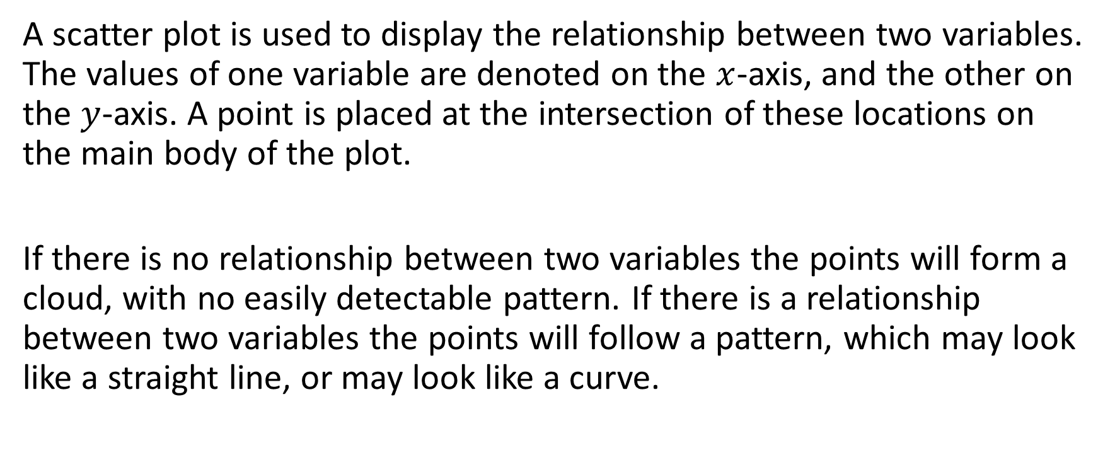
What is a scatterplot?
A scatter plot is used to display the relationship between two variables. The values of one variable are denoted on the $x$-axis, and the other on the $y$-axis. A point is placed at the intersection of these locations on the main body of the plot.
If there is no relationship between two variables the points will form a cloud, with no easily detectable pattern. If there is a relationship between two variables the points will follow a pattern, which may look like a straight line, or may look like a curve.

Slide 3
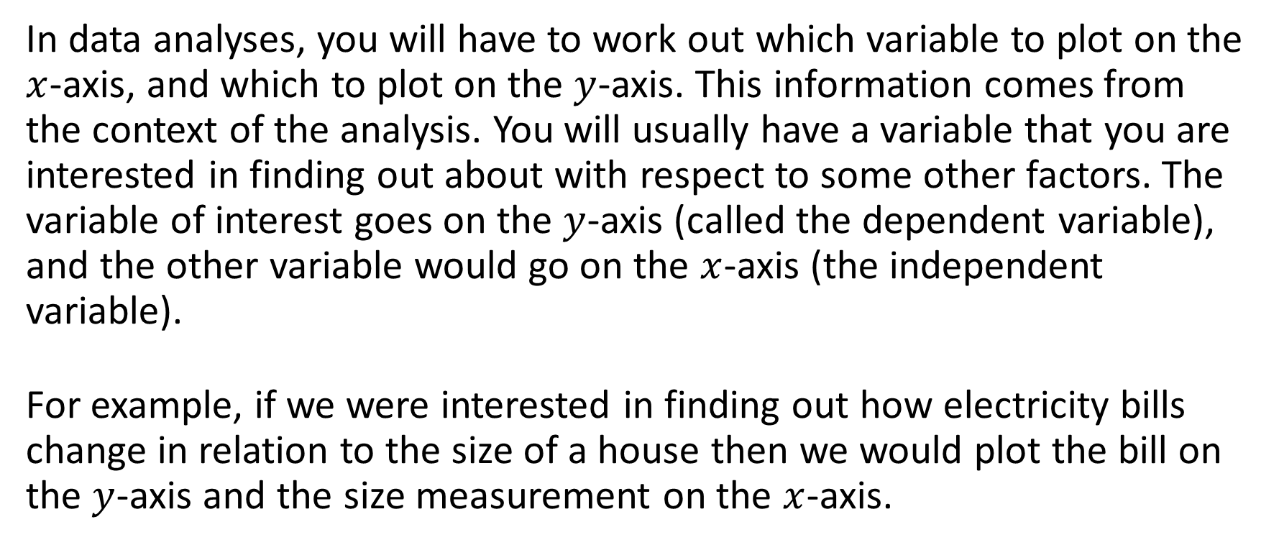
What is a scatterplot cont...
In data analyses, you will have to work out which variable to plot on the $x$-axis, and which to plot on the $y$-axis. This information comes from the context of the analysis. You will usually have a variable that you are interested in finding out about with respect to some other factors. The variable of interest goes on the $y$-axis (called the dependent variable), and the other variable would go on the $x$-axis (the independent variable).
For example, if we were interested in finding out how electricity bills change in relation to the size of a house then we would plot the bill on the $y$-axis and the size measurement on the $x$-axis.

Slide 4

Create a scatterplot of the iris data set
In R the function for creating a scatterplot is plot(x,y). Where $x$ and $y$ are the variables you want to plot on the $x$ and $y$ axis respectively. We are going to create a plot for petal length ($x$ axis) against petal with ($y$ axis) using the iris dataset
  # require the data if you have opened R
  data(iris)
  # create a scatterplot and add appropriate x and y labels
  plot(iris$Petal.Length,iris$Petal.Width, xlab="Petal length (cm)", ylab="Petal width (cm)")

Slide 5
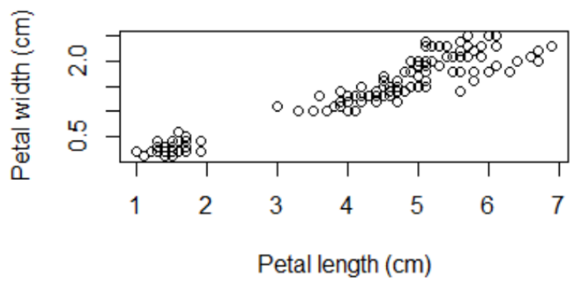
Create a scatterplot of the iris data set cont...
We can see that there seems to be a trend in that as petal length increases so too does petal width. We will discuss how to quantify this trend in the later topics of the class.

